Slide 1
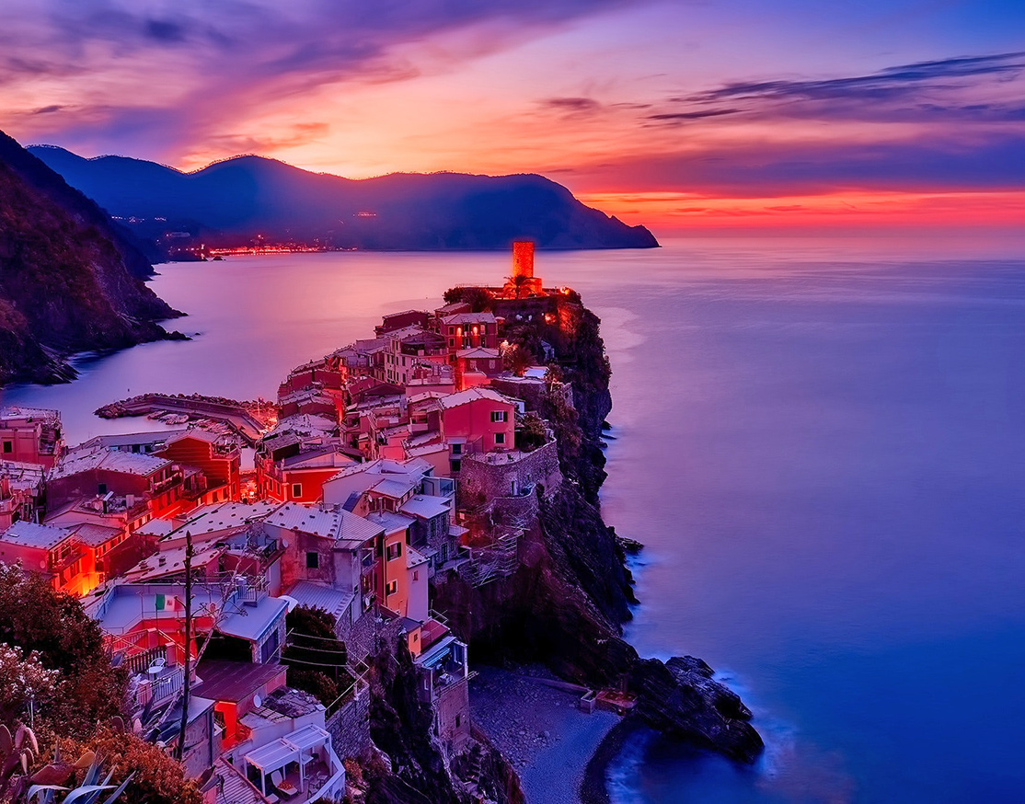
UMKC Hackathon 2019
Harish Tata
Pallavi Desai
Saitejaswi K

Slide 2
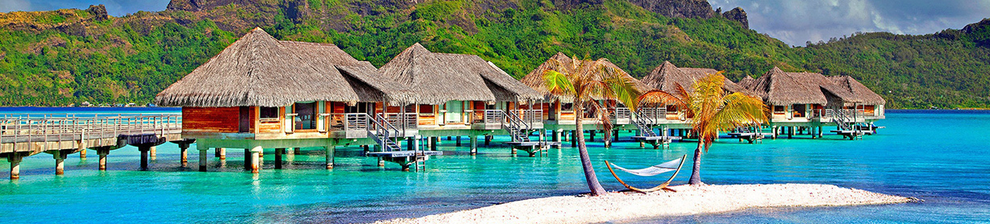
Problem Chosen
HRB3-TouristGuide

Slide 3

Objectives
Tourist guide provides the tourist with city map depending on its current location entered by the phone user.
This information helps the tourists to find the desired locations to visit.
It consists of entire details of those locations or how to reach the location and provides the basic information to decide the places to visit.
The system gives the basic details that will be required such as an image of that place along with basic details like the address.

Slide 4
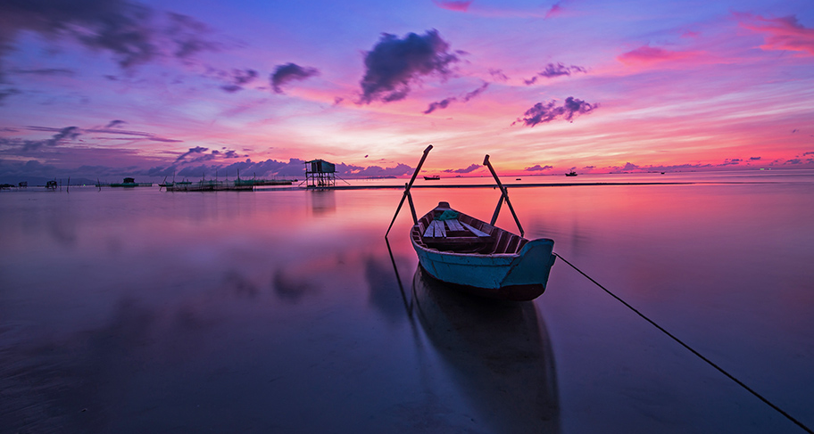
Well.. Why this ?
This project is mainly beneficial for the tourist’s having no idea about the places they want to visit.
By providing a geographic based information system the tourists and people shifting to new cities can get a better guidance of the places they want to visit.
By making the application GIS based, it includes many advantages as the user can view the required location in map and accordingly estimate the time that will be required to reach the final destination.
The system gives the basic details that will be required such as an image of that place along with basic details like the address

Slide 5







Technology Stack

Slide 6
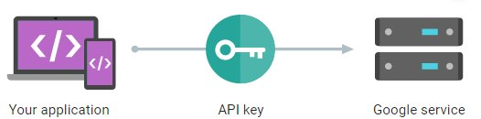
How it works

Slide 7
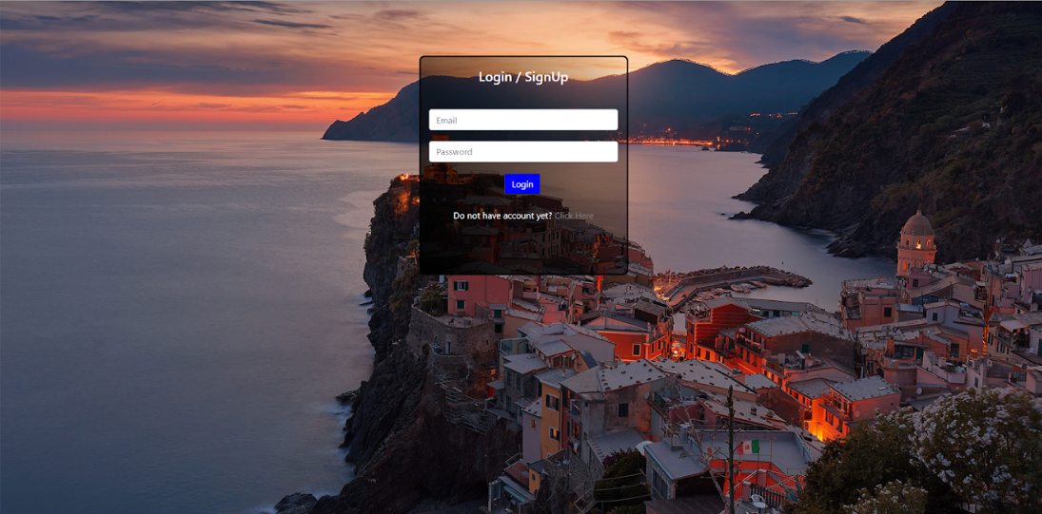
Login Page
Use need to login with valid credentials to our application
User can register, if first time user.

Slide 8
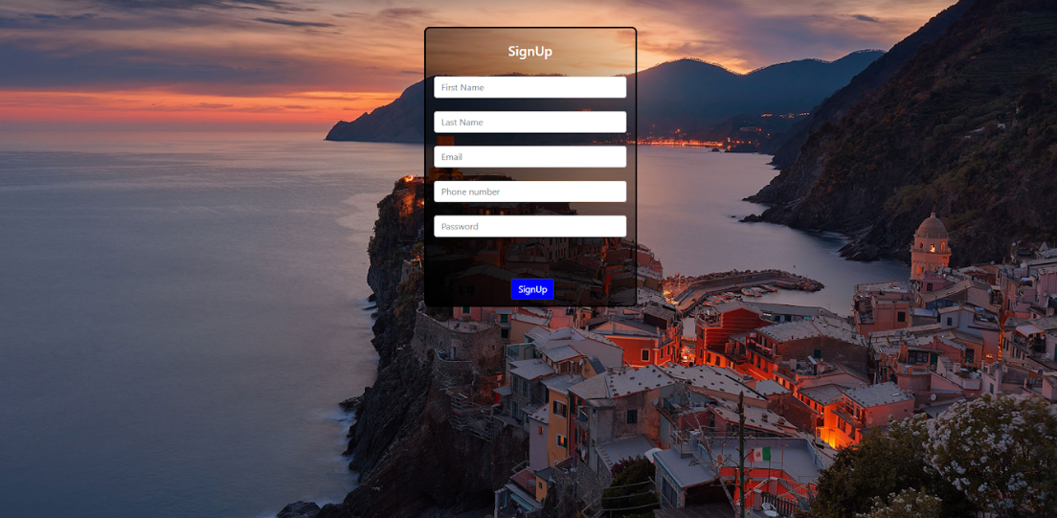
Register Page
User can register, if first time user.

Slide 9
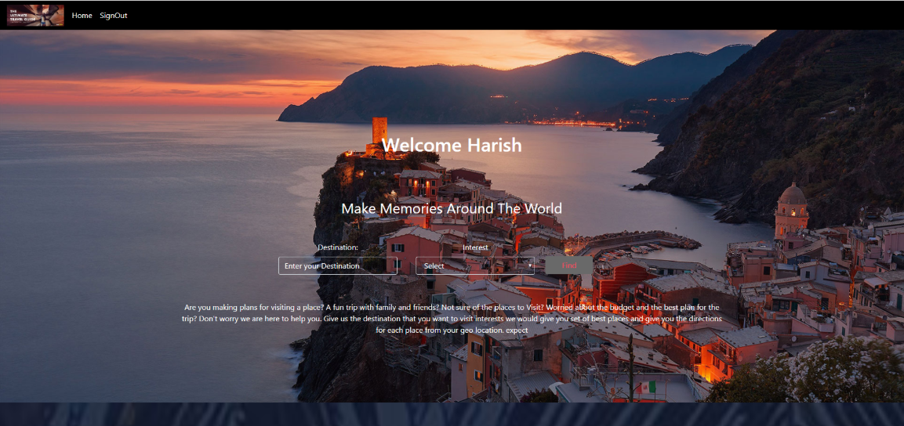
Home Page
When logged in user will be welcomed.
User can enter their place and their interests

Slide 10
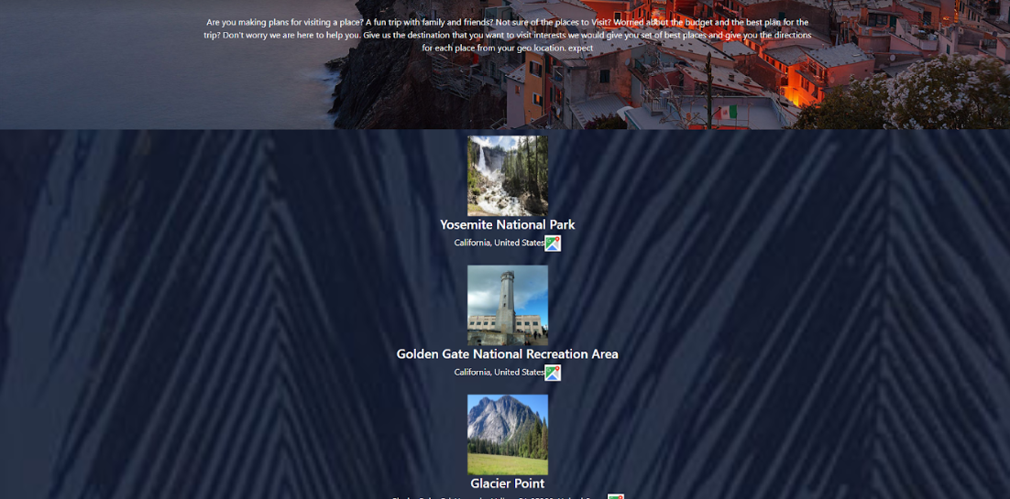
Search Page
The system gives the basic details that will be required such as an image of that place along with basic details like the address

Slide 11
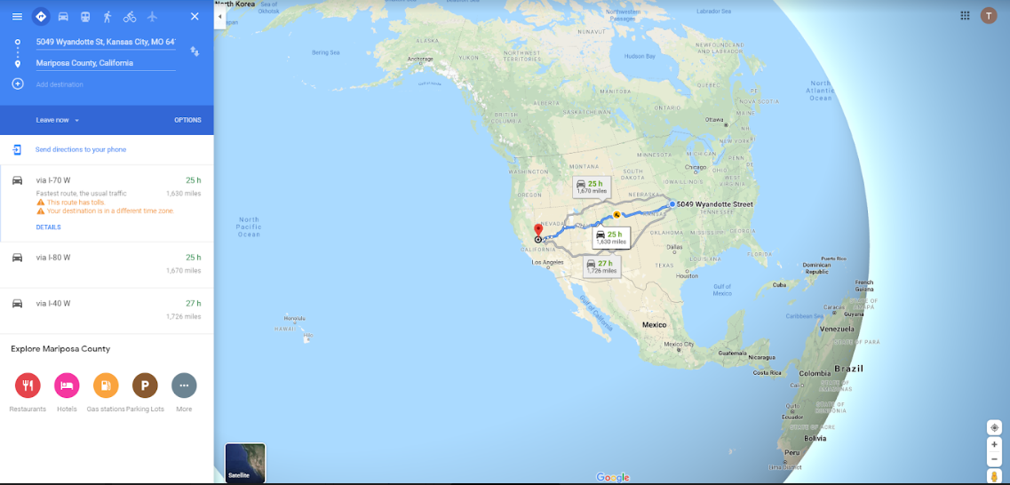
Navigation Page
The user can view the required location in map and accordingly estimate the time that will be required to reach the final destination

Slide 12
Extended
Budget based itinerary
itinerary based on days
Customized Itinerary
History of user

Slide 13

THANK YOU!
Any questions ? ☺

